Slide 1
Melanoma Identification
By Ankitha Giridhar

Slide 2
Contents
Use Case
Data Set
Data Quality Assessment
Data Exploration
Data Visualisation
Visualising the Images
Feature Engineering
Image Processing
Model Performance Indicator
ML Model – XGBoost Classifier
DL Algorithm – The Xception Network
Model Performance Comparison
Conclusion

Slide 3
Use Case
Skin cancer is the most prevalent type of cancer, and despite being the least common type, Melanoma is responsible for three fourths of all skin cancer deaths
At present, the process of identifying melanoma is cumbersome for dermatologists, as they have to manually inspect each and every mole on the patient’s body.
The goal of this project is to predict whether or not the image provided contains a cancerous mole.
The data has been taken from the SIIM-ISC Melanoma Classification competion on Kaggle, which culminated on the 17th of August, 2020.

Slide 4
The Data Used
The data includes the following:
The Images – They have been provided in the JPEG, DICOM and TFRecord formats.
The Train and Test Metadata has been provided in CSV files.
Train Columns: Image Name(unique image ID) , Patient ID, Sex, Approximate Age, Anatomical Site (Location of the tumour), Diagnosis, Benign/Malignant (whether or not the tumour was benign or malignant), Target (the encoded version of the Benign/Malignant column)
Test Columns: Image Name, Patient ID, Sex, Approximate Age, Anatomical Site

Slide 5
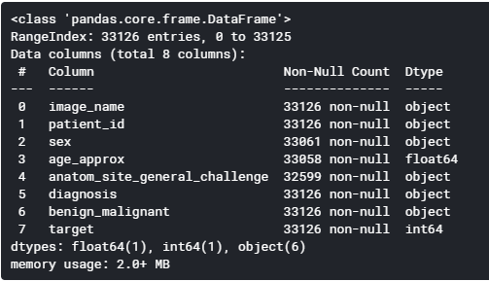
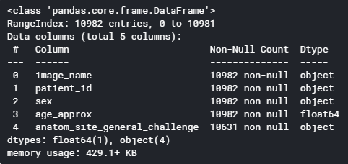
Data Quality Assessment
Train
Test

Slide 6
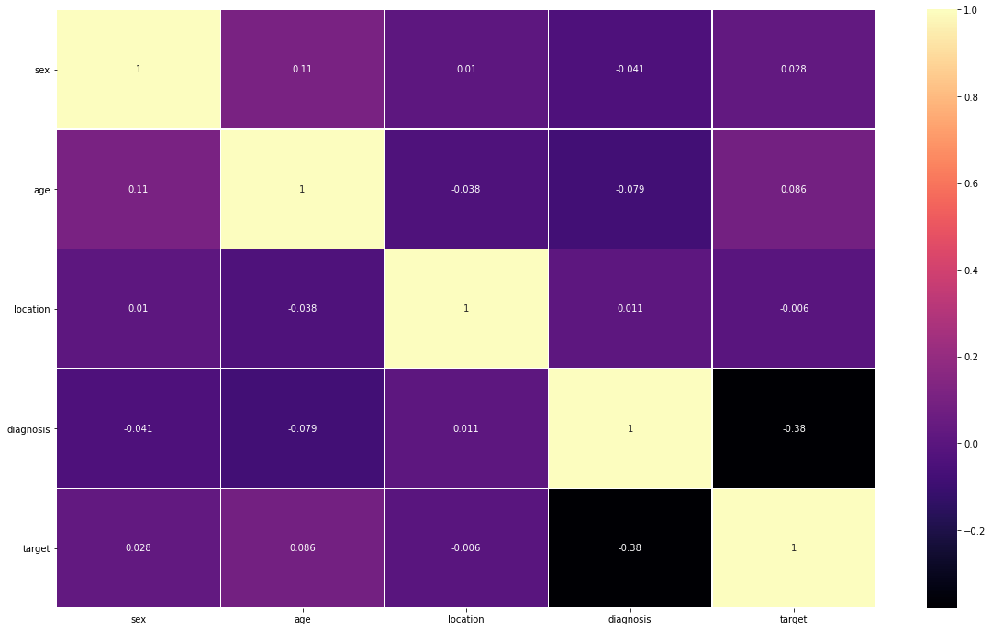
Data Exploration
Correlations between the columns

Slide 7
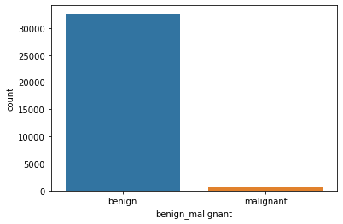
Data Visualisation
Benign – Malignant distribution In the Train Data

Slide 8
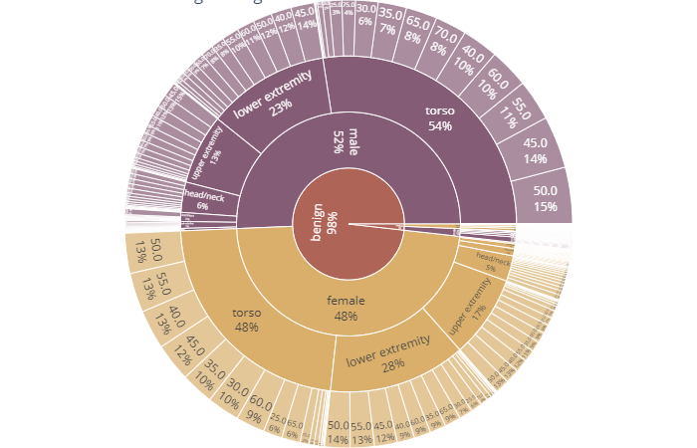
Benign-Malignant Distribution with relation to Patient Parameters

Slide 9
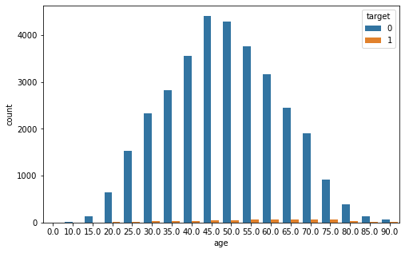
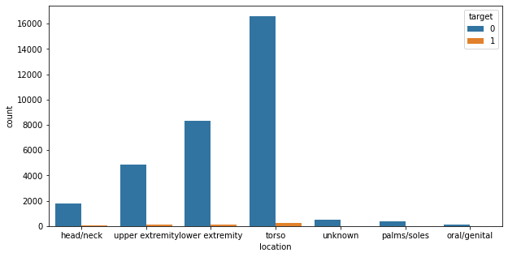
Distribution by Age
Distribution by Anatomical Location

Slide 10
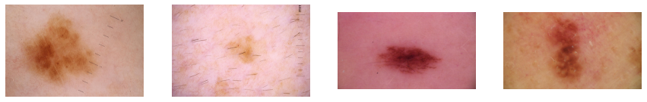
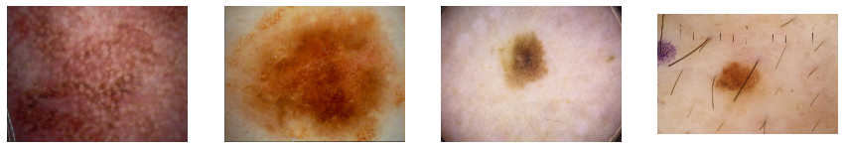
Visualising the Images
Benign
Malignant

Slide 11
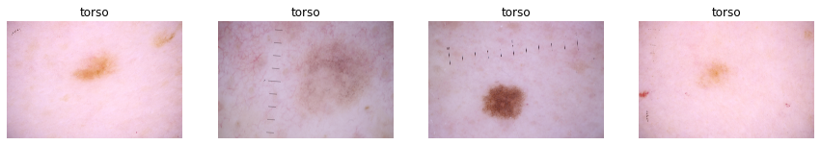
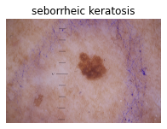
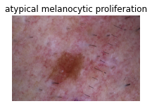
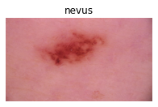
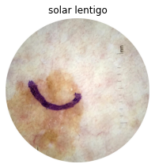
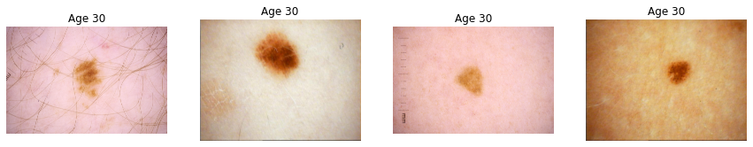
By Location
By Diagnosis
By Age

Slide 12

Feature Engineering
Missing Data

Slide 13
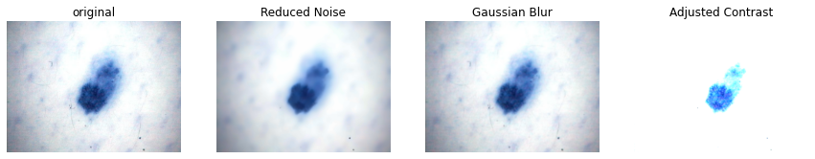
Image Processing
Gaussian Blur

Slide 14
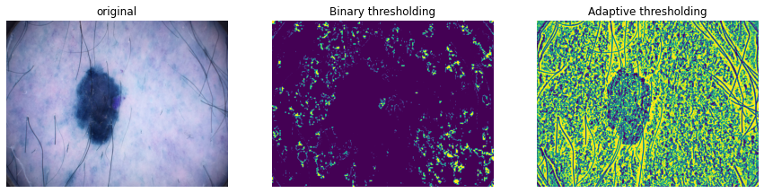
Thresholding

Slide 15
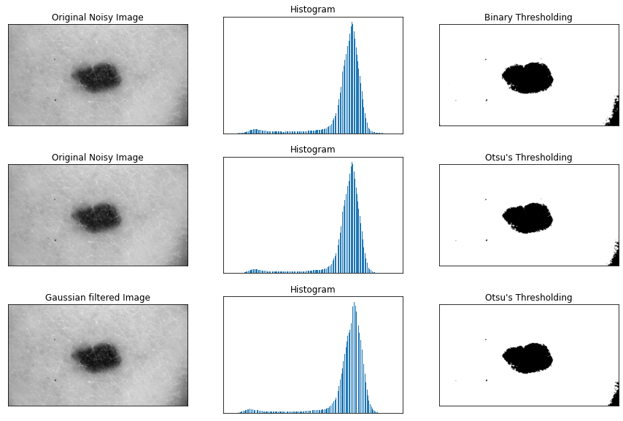
Otsu’s Thresholding

Slide 16
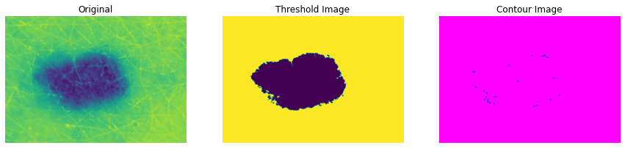
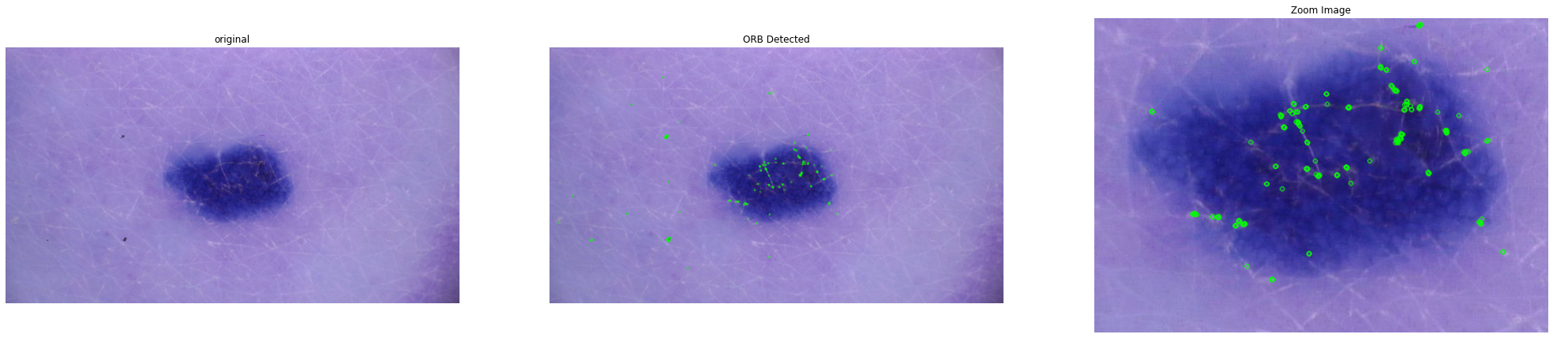
Contouring
ORB

Slide 17
Model Performance Indicator
The model performance indicator chosen is the ROC-AUC score, which is the area under the curve for the Receiver Operating Characteristic.
During diagnosis, both false positives as well as false negatives are equally dangerous, and this metric is chosen because it measures the ability of the model to distinguish between the two classes in a binary classification problem.

Slide 18

ML Model – XGBoost Classifier
A basic prediction has been done on the CSV file containing the metadata, using the XGBoost Classifier algorithm.
This model uses the Gradient Boosting Decision Tree algorithm, which is an ensemble learning method that uses multiple ‘weak’ decision stumps, learning over a loss function that is minimised over the iterations.
Performance:

Slide 19
DL Model – The Xception Network
Predictions have been attempted on the Xception Net, a kind of neural network.
This is an algorithm that was built on the principle of the Inception network (to reduce overfitting and the computational resources), but replaces Inception layers with depth-wise separable layers.

Slide 20
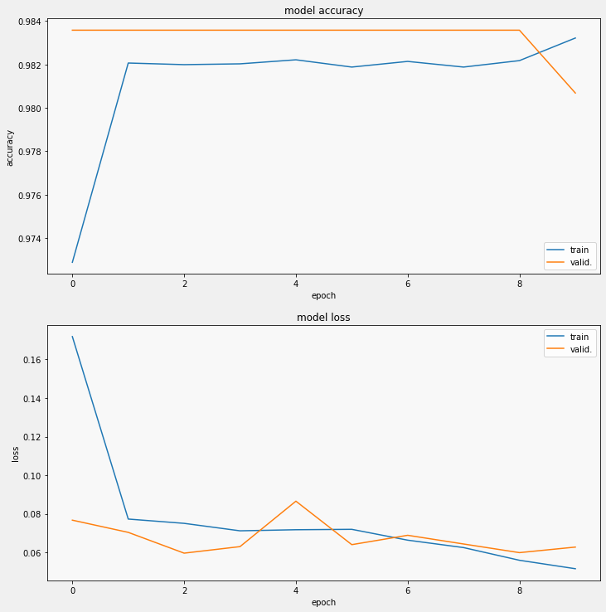

Model Performance

Slide 21
Model Performance Comparison
The XGBoost Classifier gives a ROC-AUC score of close to 0.5, which indicates that the model has no class separation capacity whatsoever.
The Xception Network gives a score of approximately 0.63
XGBoost Classifier | Xception Network
0.506 | 0.629

Slide 22
Conclusion
The XGBoost model does not perform well, indicating that the metadata itself without any feature engineering hampers its working.
The Xception Network gives a score of 0.63, indicating that it has solved the use case, predicting the target and diagnosing the images.
This can be further improved with better feature engineering. Image augmentation is also a technique that could possibly improve the Xception Network’s performance.

Slide 23
THE END

